Slide 1


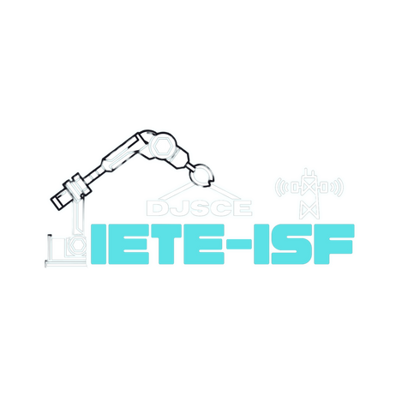







DEPARTMENT OF ELECTRONICS & TELECOMMUNICATION ENGINEERING
PRESENTS
2.0
A 24-HOUR HARDWARE HACKATHON
POWERED BY
ROUND 2 Submission

Slide 2

Introduction
2.0
A 24-HOUR HARDWARE HACKATHON
[Team Name]:Circuit Sages
[Member Names]:
1)Swaraj Todkar​
2)Yash Gunjal​
3)Pradhynan Lohar​
4)Ritik Kumar​
5)Oamkar Dhanwate
6)Sonawane Dhaval
[College Name]: Vishwakarma Institue of Technology,Pune

Slide 3
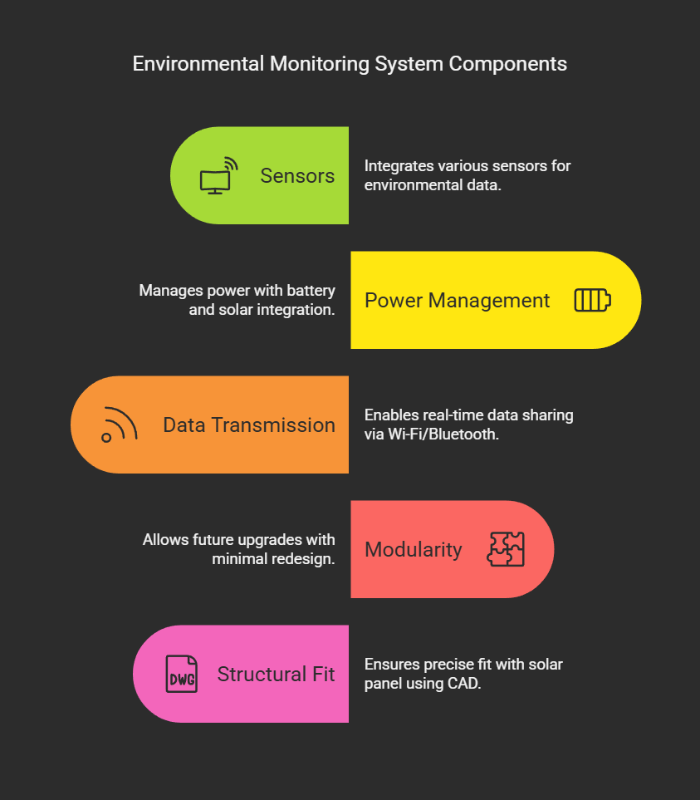
PROBLEM STATEMENT
# Content:
Urban Challenges: Rapid urbanization has led to increased environmental concerns such as air pollution, noise pollution, and climate change. Cities require real-time monitoring systems to ensure sustainable development and improve the quality of life for residents.
Current Limitations: Existing environmental monitoring systems are often:
Expensive and non-scalable.
Lack modularity for future upgrades.
Inefficient in power management and data transmission.
Project Goal: Design and develop a modular PCB that serves as the backbone of an intelligent environmental monitoring system for smart cities.

Slide 4
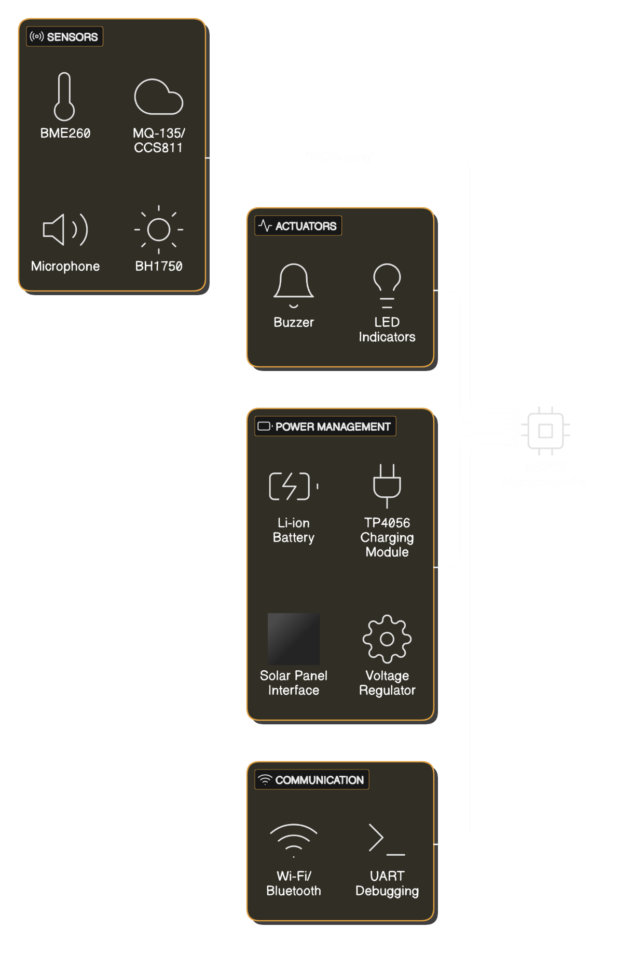
BLOCK DIAGRAM

Slide 5
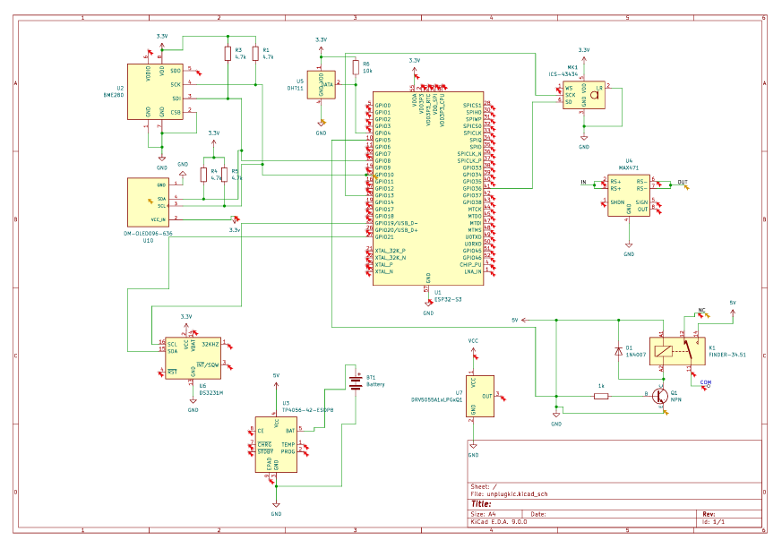
SCHEMATIC DIAGRAM

Slide 6
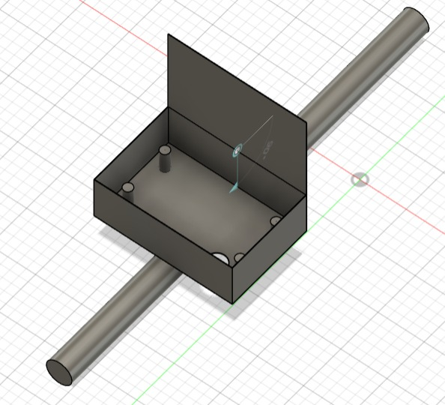
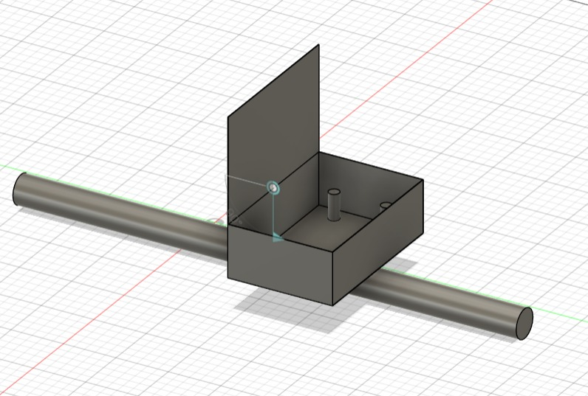
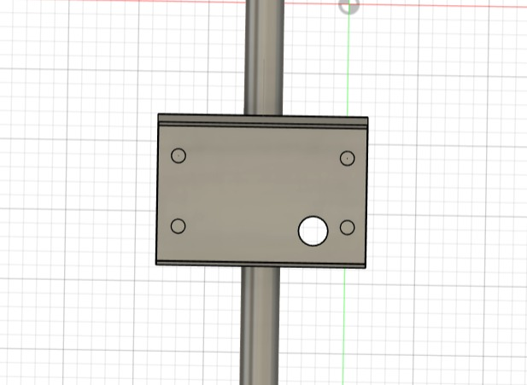
PCB OUTERCASE

Slide 7

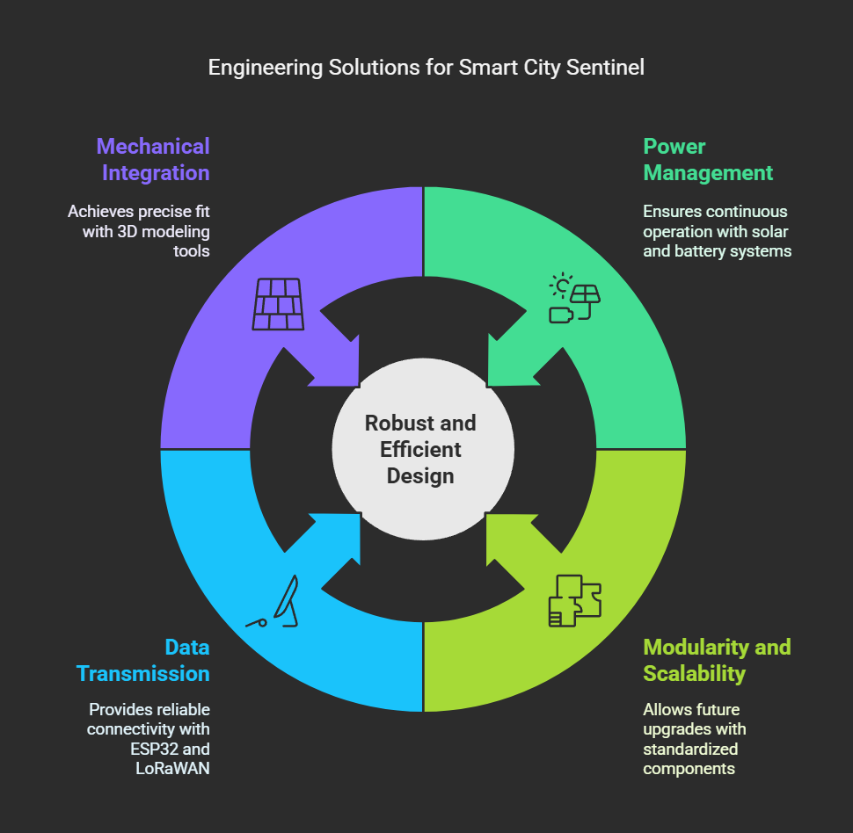
Challenges and Solutions
Challenge: Efficient Power Management
Problem: Ensuring continuous operation with limited power resources, especially when integrating a solar panel and battery system.
Solution:
Used a TP4056 charging module for battery monitoring and recharging.
Integrated a voltage regulator (e.g., LM7805 or buck converter) to provide stable 3.3V/5V supply to all components.
Added a solar panel interface with a diode to prevent reverse current and ensure efficient energy harvesting.
Challenge: Modularity and Scalability
Problem: Designing a system that allows easy upgrades and replacements without significant redesign.
Solution:
Incorporated standardized headers for connecting sensors and actuators.
Left unused GPIO pins accessible for future expansions.
Designed the PCB layout to accommodate additional components if needed.
Challenge: Reliable Real-Time Data Transmission
Problem: Ensuring seamless communication in urban environments with potential connectivity issues.
Solution:
Leveraged the ESP32’s dual Wi-Fi and Bluetooth capabilities for robust communication.
Planned future integration of LoRaWAN for long-range, low-power data transmission in areas with limited connectivity.

Slide 8
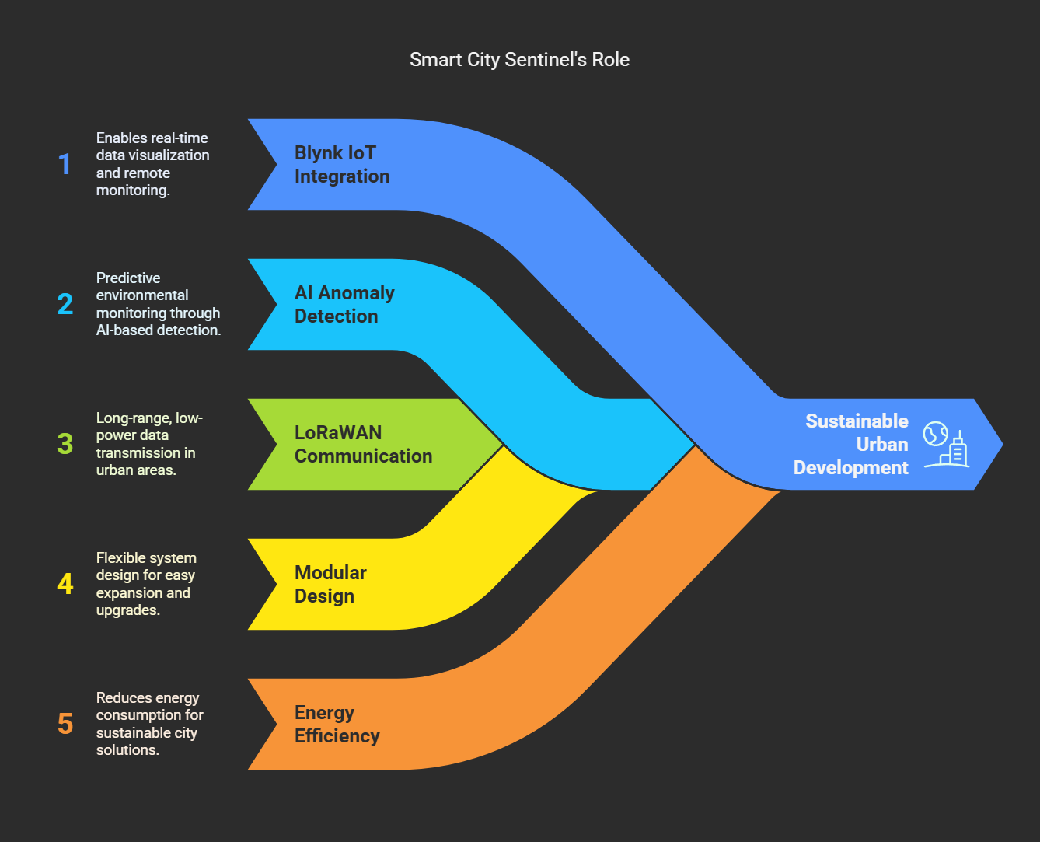
Future Enhancements
The Smart City Sentinel is designed with scalability and adaptability in mind, allowing for future enhancements to meet evolving urban needs. Potential upgrades include:
Blynk IoT Integration:
Enable real-time data visualization and remote monitoring through a user-friendly IoT platform.
AI-Based Anomaly Detection:
Implement machine learning algorithms for predictive monitoring and early detection of environmental anomalies.
LoRaWAN Communication:
Integrate long-range, low-power communication for data transmission in areas with limited Wi-Fi coverage.
City-Wide Network Integration:
Connect multiple Sentinel units to a centralized city-wide monitoring network for comprehensive environmental surveillance.

